Slide 1





Weekly Report
3rd Aug, 2020
Location : Meeting room 1
Plan for E-PCR
Title
July
August
October
November
Project identification
Get requirement
System analysis
System design
Code programming
UAT & Unit test
Training & Trial
Document
N O W
WEEK 1
WEEK 2
WEEK 3
WEEK 4
- Edit mock up E-PCR system
- Confirm requirement
is E-PCR system with user
- Present Mock up E-PCR system
- Analysis E-PCR system
- Design database and
diagram
Remark :
Achieved
On process
Not Achieved

Slide 2
Weekly Report
3rd Aug, 2020
Location : Meeting room 1
Plan for E-PCR
Title
July
August
October
November
Project identification
Get requirement
System analysis
System design
Code programming
UAT & Unit test
Training & Trial
Document
N O W
Result on last week
Target in this week
Edit mock up E-PCR system
Present Mock up E-PCR system
Analysis E-PCR system
Confirm requirement is
E-PCR system with user
Design database and diagram
Remark :
Achieved
On process
Not Achieved

Slide 3
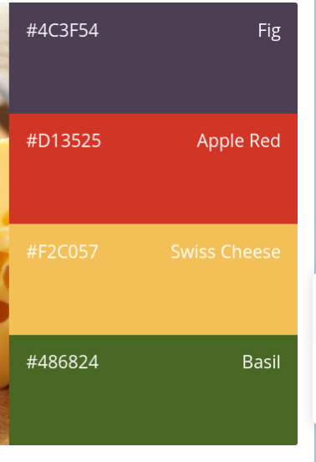
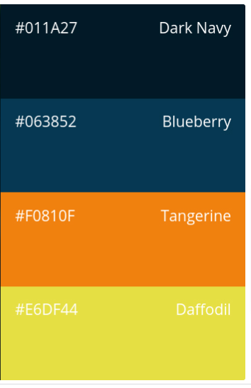
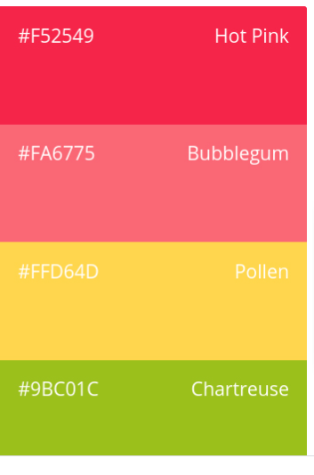
Weekly Report
20th Jul, 2020
Location : Meeting room 1
Target in this week
นำเสนอ mock up หน้าจอของระบบ
Result on last week
เก็บ Requirement กับ user ครั้งที่ 2
นำเสนอ Standard Code
ปรับปรุง การออกแบบ mock up ของระบบ
จัดทำรายงานการประชุมครั้งที่ 1
เก็บ Requirement กับ user ครั้งที่ 1
Achieved
On process
Not Achieved

Slide 4
Weekly Report
TUE
WED
MON
Result on last week
Result on last week
Result on last week
Target in this week
Target in this week
Target in this week
MON
TUE
WED
THU
FRI
Result on last week
Target in this week
Result on last week
Target in this week
THU
FRI

Slide 5

